Slide 1

Amazon Product Dataset Analysis
A comprehensive analysis of 1,465 Amazon product records — covering categories, pricing, discounts, ratings, and customer reviews. This report identifies top trends, key anomalies, and strategic recommendations to support e-commerce dashboard development and business decision-making.
1,465 PRODUCTS
13 CATEGORIES
DATASET-DRIVEN INSIGHTS

Slide 2

Dataset Overview & Column Reference
This dataset contains 1,465 Amazon product records with product details, pricing, ratings, and customer reviews. It is ideal for building an e-commerce product/catalog and review analysis dashboard. Important limitation: There is no sales quantity, revenue, or geographic Region column — this is product and review data, not a true sales dataset.
Product & Pricing Columns
Rating & Review Columns
product_id — Unique ID for each product
product_name — Name/title of the Amazon product
category — Main product category
sub_category — More specific product type
actual_price — Original/list price
discounted_price — Price after discount
discount_percentage — Percentage discount
img_link — Product image link
product_link — Amazon product page
rating — Customer rating, usually out of 5
rating_count — Number of customer ratings/reviews
about_product — Description/features of the product
user_id — Identifier associated with reviewers
user_name — Reviewer name
review_id — Review identifier
review_title — Review headline
review_content — Written customer review
No revenue, units sold, profit, or geographic region columns exist in this dataset. Conclusions should be framed as business implications and hypotheses, not proven financial outcomes.

Slide 3
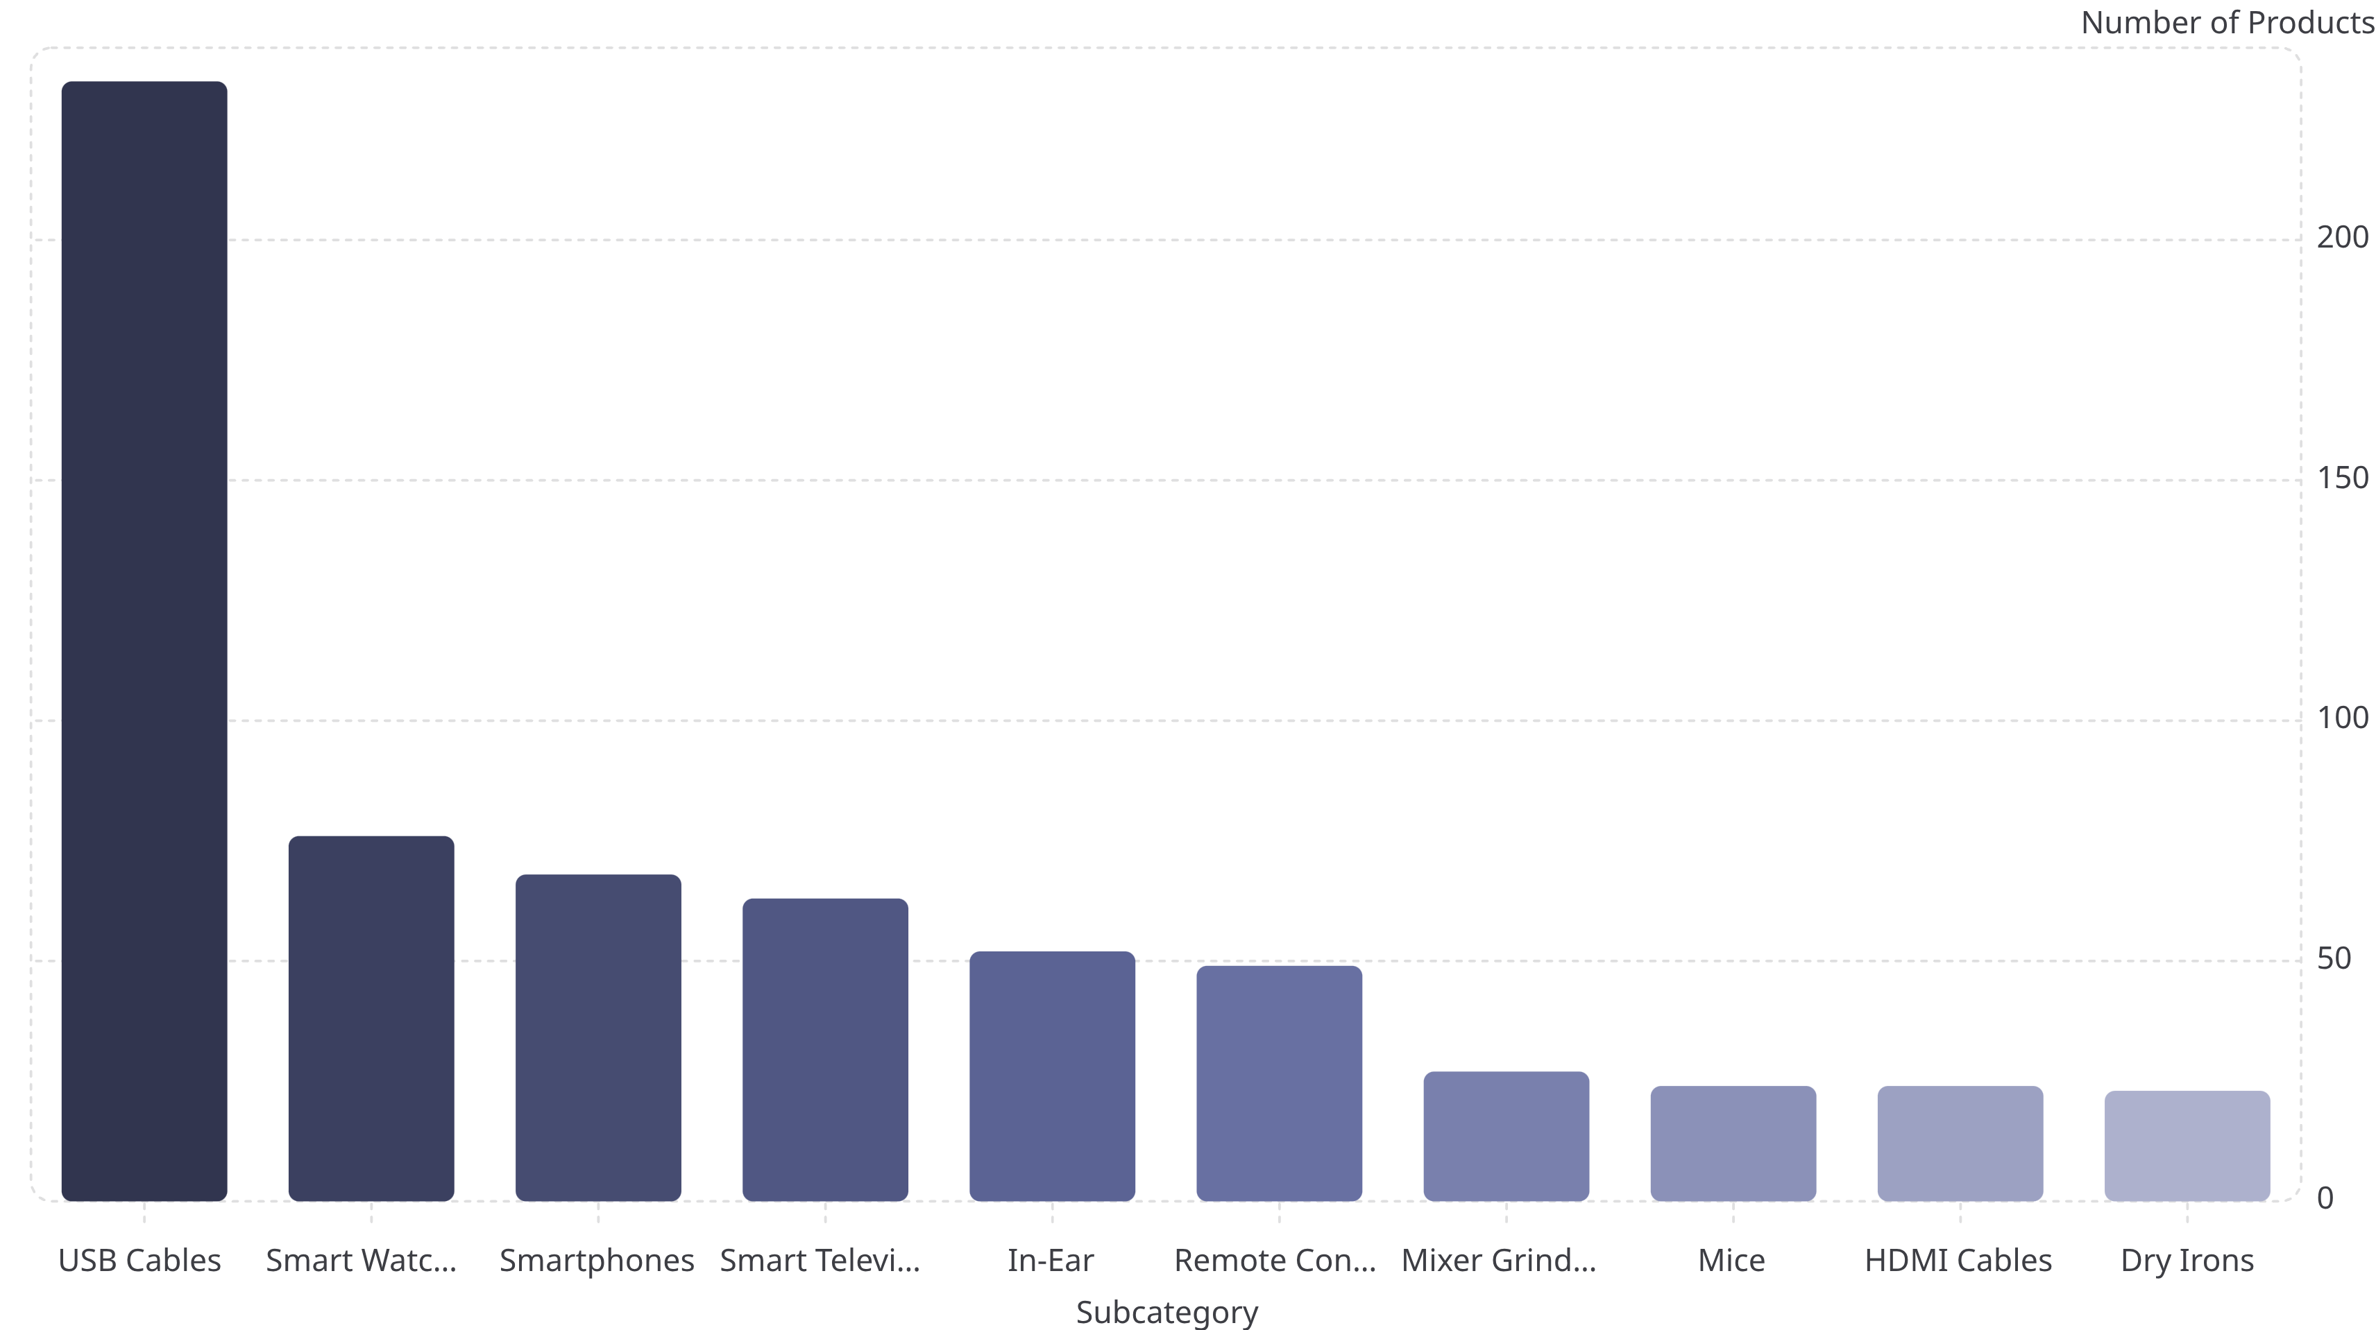
Top Trending Subcategories
USB Cables dominate the subcategory landscape with 233 products — nearly three times more than the next-ranked subcategory. Smart Watches (76), Smartphones (68), and Smart Televisions (63) round out the top four. This concentration in connectivity and smart consumer electronics reflects strong market demand in these segments.
USB cables have by far the largest product presence in the dataset. The sharp drop-off after the top four subcategories underscores the heavy concentration of listings in connectivity and smart electronics products.

Slide 4
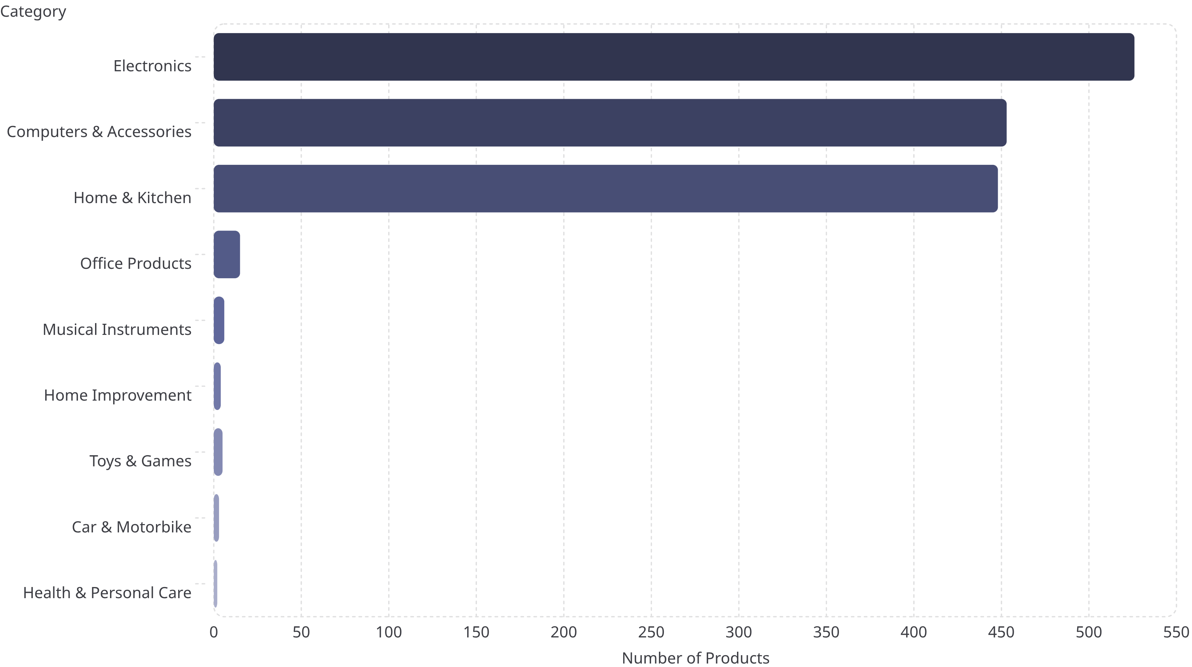
Top Product Categories
Three categories dominate the dataset, together representing almost the entire product catalog. Electronics leads with 526 products, followed closely by Computers & Accessories (453) and Home & Kitchen (448). This concentration reveals both a strength in these segments and a potential risk of overdependence on a small number of product groups.
Electronics, Computers & Accessories, and Home & Kitchen account for the vast majority of the 1,465 products in the dataset. All other categories combined represent a small fraction of total listings, highlighting significant category concentration.

Slide 5
Key Business Metrics at a Glance
The dataset reveals a marketplace characterized by aggressive promotional pricing, generally positive customer satisfaction, and a small number of products attracting outsized customer attention. These four KPIs form the foundation of any Amazon product analysis dashboard.
1,465
4.10
Total Products
Avg Rating /5
Across 13 main categories and dozens of subcategories in the dataset.
The most common individual rating is 4.1, indicating generally positive customer feedback.
47.7%
₹3,125
Avg Discount
Avg Discounted Price
Median discount is 50%, suggesting aggressive promotional pricing is common across the marketplace.
Compared with an average actual price of ₹5,445 — a substantial reduction from list price.
Products with very large review counts include Amazon Basics HDMI cables and boAt Bassheads 100 earphones, suggesting strong customer engagement. This dataset can be used to analyze what products are being sold, their prices, discounts, ratings, and customer reviews.

Slide 6

Top Trends Summary
Five dominant trends emerge from the 1,465-product dataset, each with direct implications for dashboard design and business strategy.
🔥 Electronics Dominates
🔌 USB Cables Lead Subcategories
💸 Heavy Discounting Is the Norm
Electronics (526), Computers & Accessories (453), and Home & Kitchen (448) together represent almost the entire dataset. This concentration is both a strength and a potential vulnerability.
With 233 products, USB Cables far outpace all other subcategories. Smart Watches (76), Smartphones (68), and Smart TVs (63) follow as the next most represented segments.
Average discount of 47.7% with a median of 50% indicates that promotional pricing is standard practice. A few products exceed 90% discount, which warrants investigation.
⭐ Ratings Are Generally Positive
📣 Few Products Drive Massive Engagement
Average rating of 4.10/5 with 4.1 as the most common individual score reflects strong customer satisfaction across the product catalog.
A small number of products attract hundreds of thousands of ratings, dramatically higher than the dataset median of roughly 1,186 ratings per product.

Slide 7
Important Anomalies to Flag
Four categories of anomalies require attention during data cleaning and analysis. These outliers can distort KPIs, product counts, average ratings, and category-level conclusions if left unaddressed.
⚠️ Extremely High Review Counts
🏷️ Very High Discounts
Some products have dramatically more reviews than the typical product, which has a median of roughly 1,186 ratings:
A few products have discounts above 90%, substantially above the typical 50% level. These should be flagged as potential pricing anomalies:
AmazonBasics HDMI Cable: ~426,973 ratings
boAt Bassheads 100: ~363,713 ratings
USB-C adapter: 94% discount
Fire-Boltt smartwatch: 91% discount
These are major outliers that can skew average rating counts and popularity metrics across the dataset.
🔁 Duplicate-Looking Products
Repeated or similar product records appear throughout the dataset, particularly among highly reviewed products. For example, the same AmazonBasics HDMI product appears multiple times with essentially identical information. Duplicates distort:
💰 Extreme Prices
Most products have much lower prices, but some high-end products are extreme outliers:
Highest original price: ₹139,900 — Sony Bravia 65" TV
Other TVs and ACs reach ₹75,000–₹85,000+
Product counts
Average ratings
Review counts
Category analysis

Slide 8
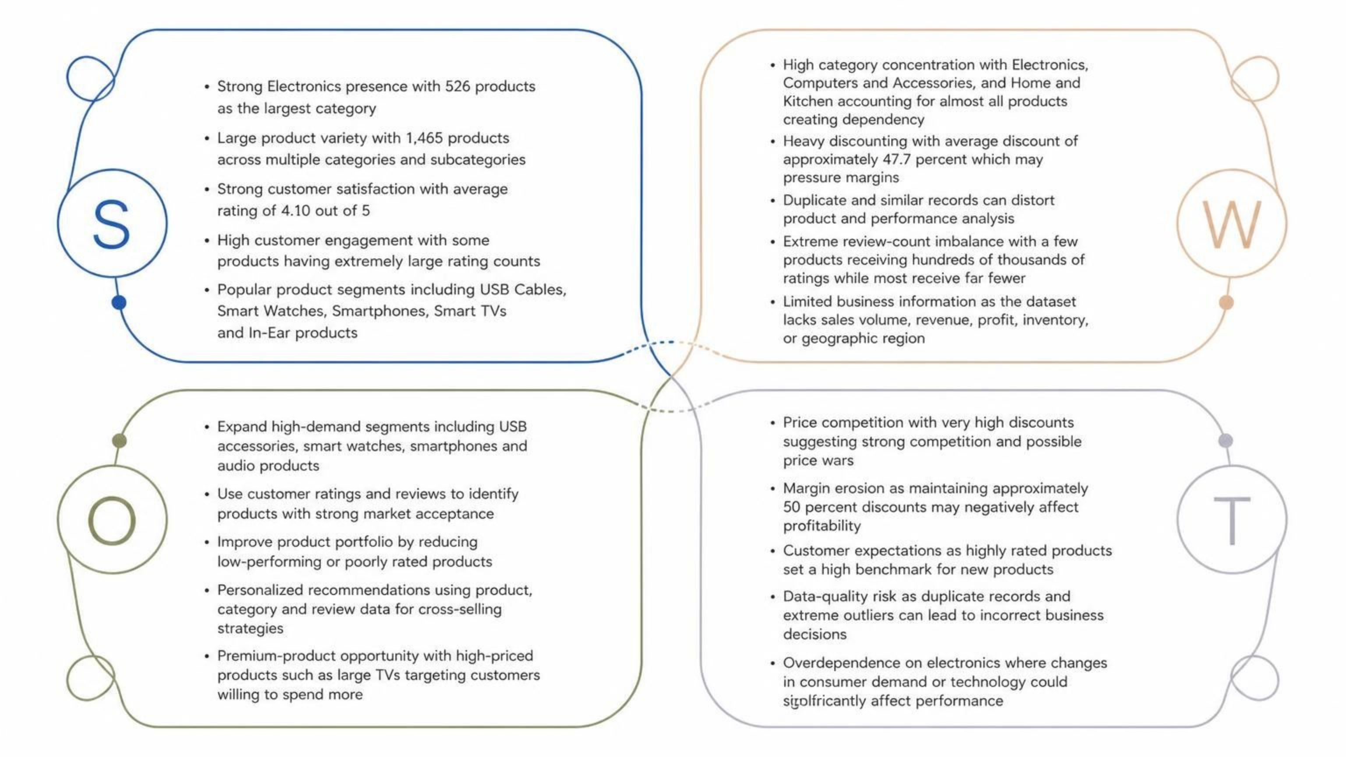
SWOT Analysis — Amazon Product Marketplace
Based on the 1,465 product records, this SWOT analysis frames findings as business implications and hypotheses. Note: Without revenue, units sold, or profit data, these should not be interpreted as proven financial outcomes.

Slide 9

Reactive Case Studies
Four reactive scenarios translate SWOT findings into concrete business actions. Each addresses a specific anomaly or trend requiring immediate attention.
1
2
High Discounts
Review Outliers
Average discount is ~47.7%, with some products exceeding 90%. Actions: Investigate whether extreme discounts are genuine; identify products where discounts reduce profitability; introduce discount thresholds; focus promotions on products where discounts increase demand. Expected result: Better balance between sales attractiveness and profitability.
Some products have hundreds of thousands of ratings, dramatically higher than the typical product. Actions: Identify what makes these products successful; analyze their price, category, rating, and discount; use successful products as benchmarks; promote similar products with strong potential. Expected result: Turn high-performing products into a product strategy benchmark.
3
4
Category Concentration
Data Quality
Electronics has 526 products, while Computers & Accessories and Home & Kitchen have 453 and 448 respectively. Actions: Monitor category performance; identify underserved categories; diversify where sufficient customer demand exists; avoid over-reliance on a small number of product groups. Expected result: A more balanced and resilient product portfolio.
Duplicate products and extreme values can distort KPIs. Process: Raw Data → Cleaning → Validation → Dashboard → Business Decision. Actions: Remove duplicate records; validate prices and discounts; check extreme rating counts; standardize categories/subcategories; validate missing values. Expected result: More reliable KPIs and business decisions.

Slide 10

Strategic Recommendations & Dashboard Priorities
"Focus on high-engagement product segments while controlling excessive discounting, improving data quality, and diversifying the product portfolio."
🔴 High Priority
📊 Recommended Power BI Dashboard Pages
Investigate discounts above 90%
Clean duplicate records
Investigate extreme review-count outliers
Monitor profitability impact of heavy discounting
A dedicated Top Trends + Anomalies page should include:
Top 10 subcategories → bar chart
Average discount by category → bar chart
Price vs. rating → scatter plot
Top products by rating count → bar chart
Discount outliers → table
🟠 Medium Priority
Optimize the Electronics portfolio
Analyze high-performing subcategories
Identify products with strong ratings but low visibility
📌 KPI Cards
🟢 Growth Opportunity
1,465
4.10
Expand successful product segments (USB, Smart Watches, Audio)
Cross-sell related products using review and category data
Develop personalized recommendation strategies
Explore underserved categories for diversification
Products
Avg Rating
47.7%
₹3,125
Avg Discount
Avg Price
Important limitation: Because this dataset lacks revenue, units sold, profit, and region, the SWOT and recommendations should be described as business implications and hypotheses — not proven financial outcomes.

